Slide 1
EE356 – ELECTRONIC Product design and manufacture
E/17/043 – Chulawansa s.m.d.s.
e/17/183 – Lakshan g.a.d.
e/17/235 – Paranawithana n.n..k.

Slide 2
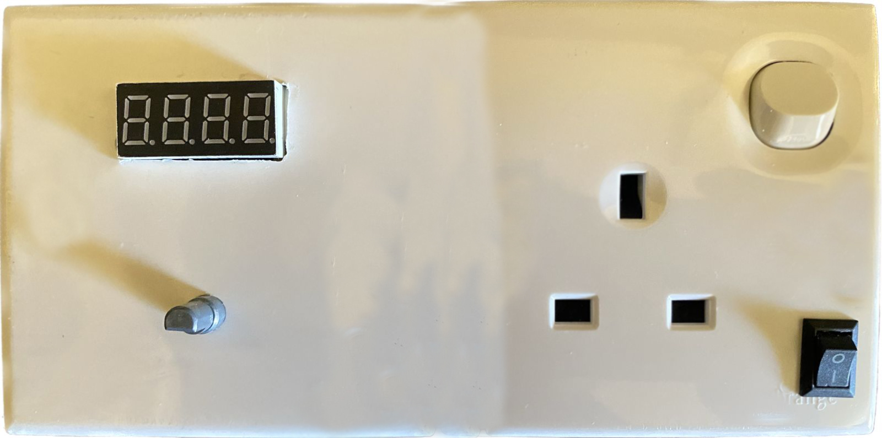
EE356 – ELECTRONIC Product design and manufacture

Slide 3
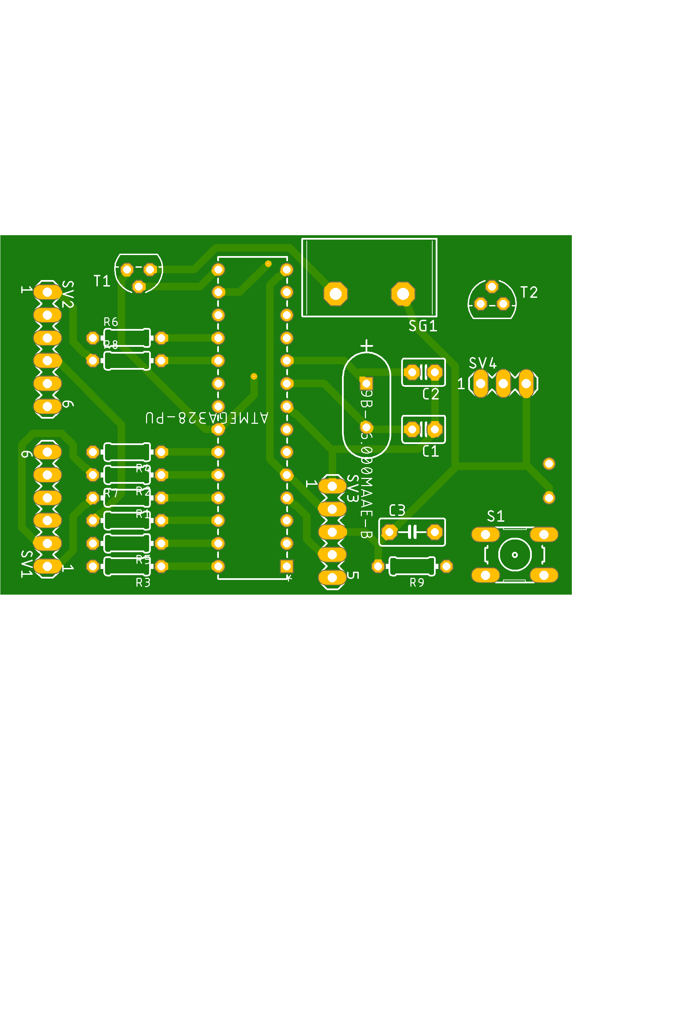
Introduction

Slide 4
Introduction
This is designed as a good substitute for the ordinary plug socket that we use in domestic day today life.
Our main purpose is to replace the ordinary plug socket with our designed one and go for mass production.
So we mainly target the majority people in our country with basic needs of using electrical appliances.
This plug socket can be fix to the wall as the ordinary plug socket which is already in the market ,no additional parts needed.

Slide 5
We can see mostly timer switches in the market but not the timer plug sockets. The switches are very expensive in the market(more than twice the price of our product) and again they need a ordinary plug socket to plug the device.so approach of timer switches to the majority of our people will less with the price.
Our product is more approachable to the majority of people with the price and good substitute to the ordinary plug socket and price can be reduced with mass production.

Slide 6
Designed electrical timer plug socket can be used for any device even though with the devices which are already consists with inbuild timers. Because the plug can be operated independently without the timer as well.
Very useful product these days with the issue of power consumption in our country.
Can be used for domestic appliances such as of radios, televisions, fans, water pumps, air conditioners, coil heaters ,boilers, lights…etc.
This plug socket can be used as a safety precaution of the domestic appliances and people as well. For example when using coil heaters…(accidents regarding coil heaters and burnt out of the device frequently with ignorance can be reduced)

Slide 7
CIRCUIT COMPONENTS

Slide 8
ATMEGA328PU IC
4 Digits 7 Segment LED Display
Rotary Encoder
5V Relay
Two Way Switch
AC-DC Converter (230V-5V)
Buck Converter (5V-3.3V)

Slide 9
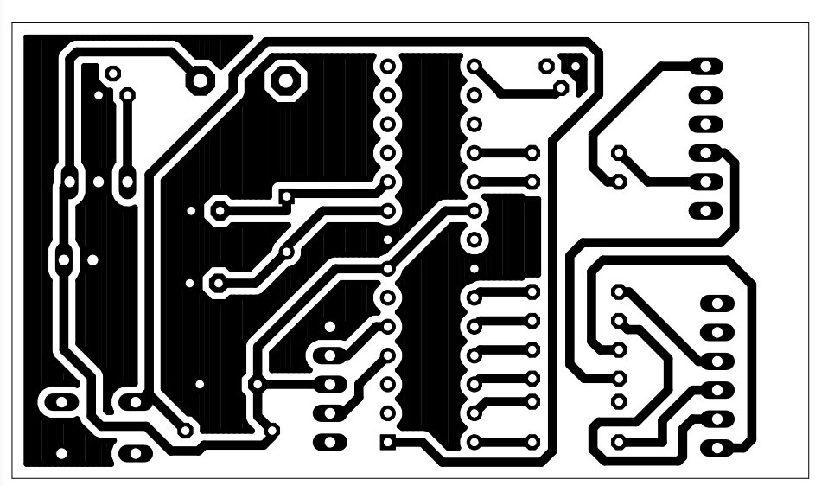
PCB DESIGN

Slide 10
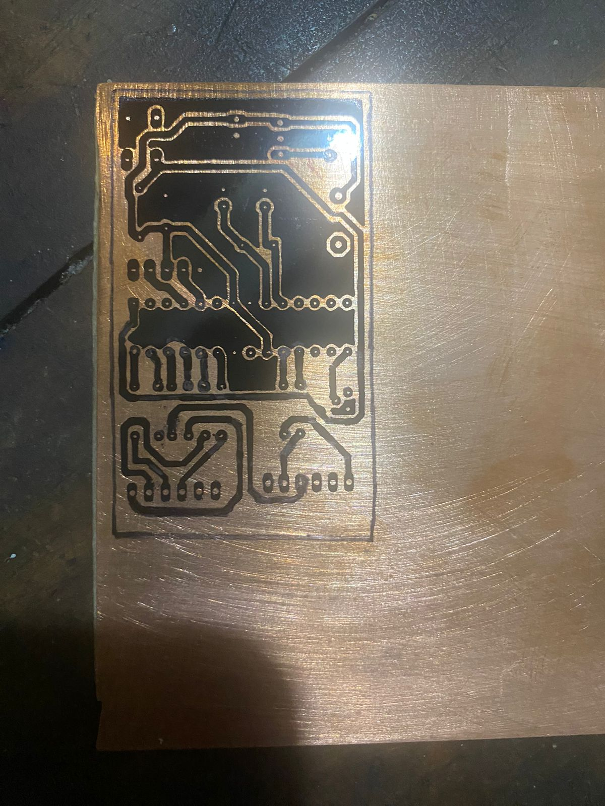
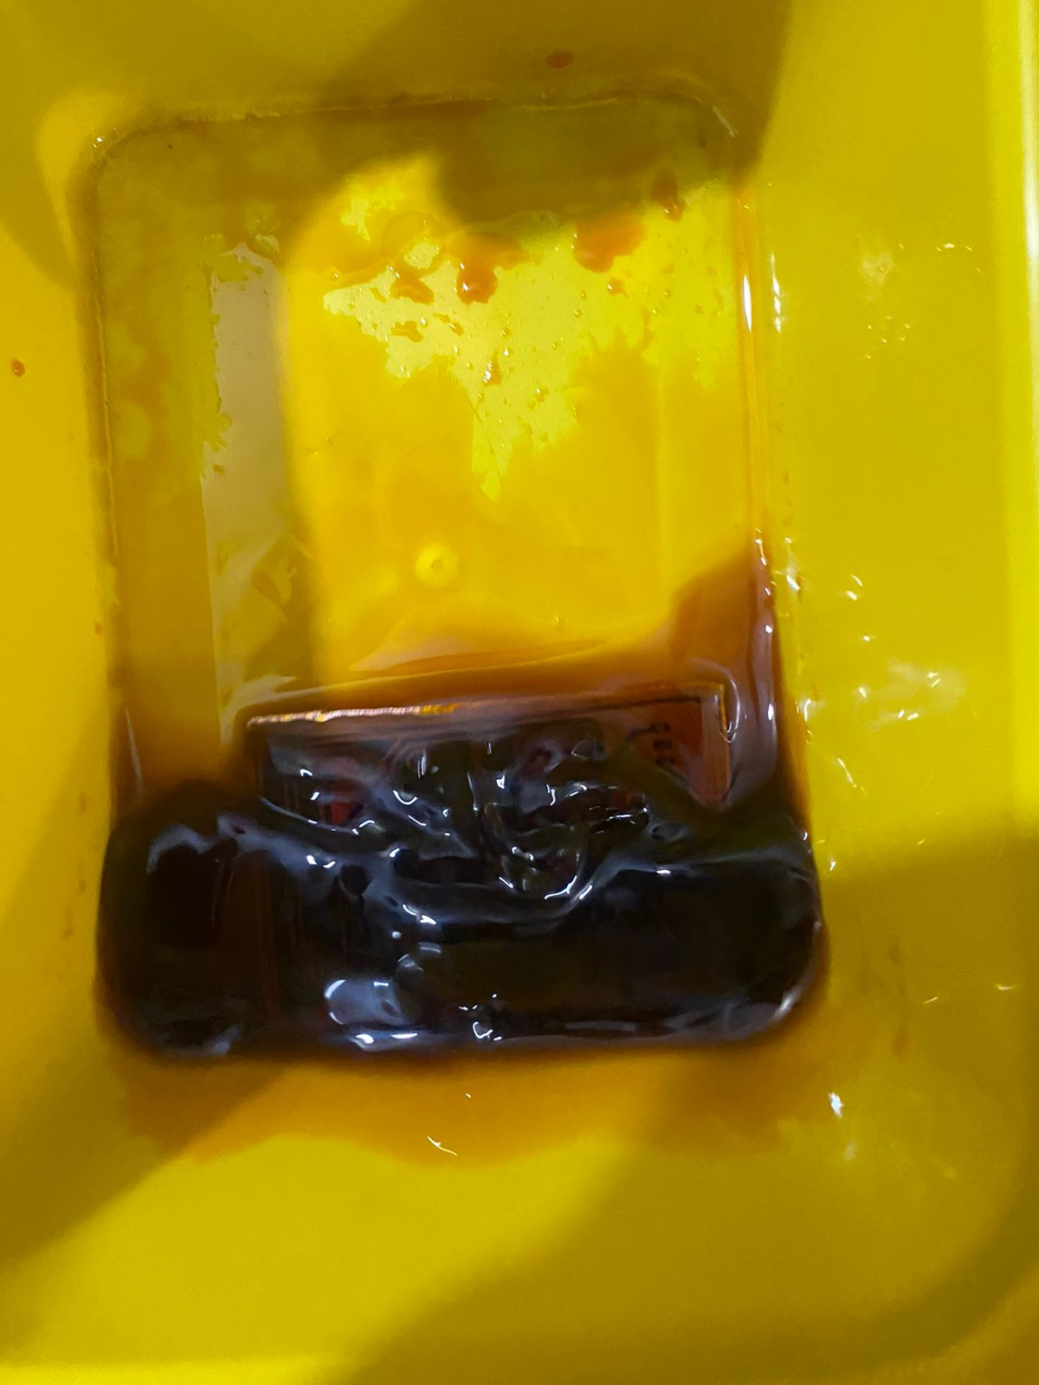
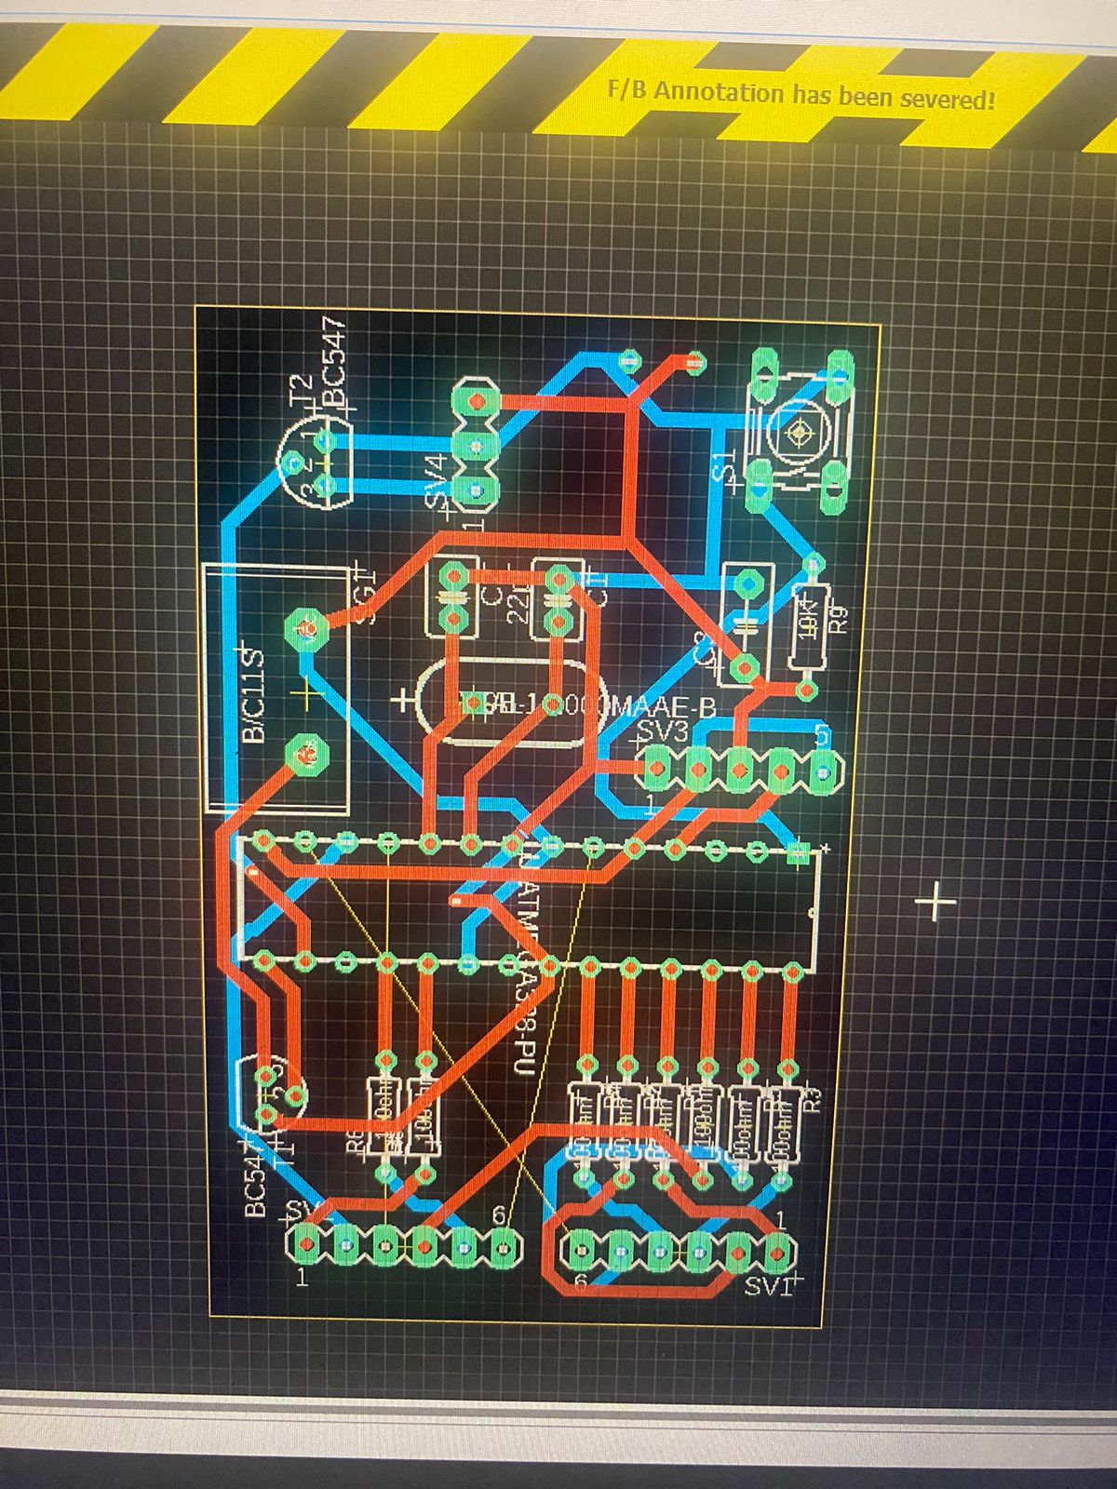
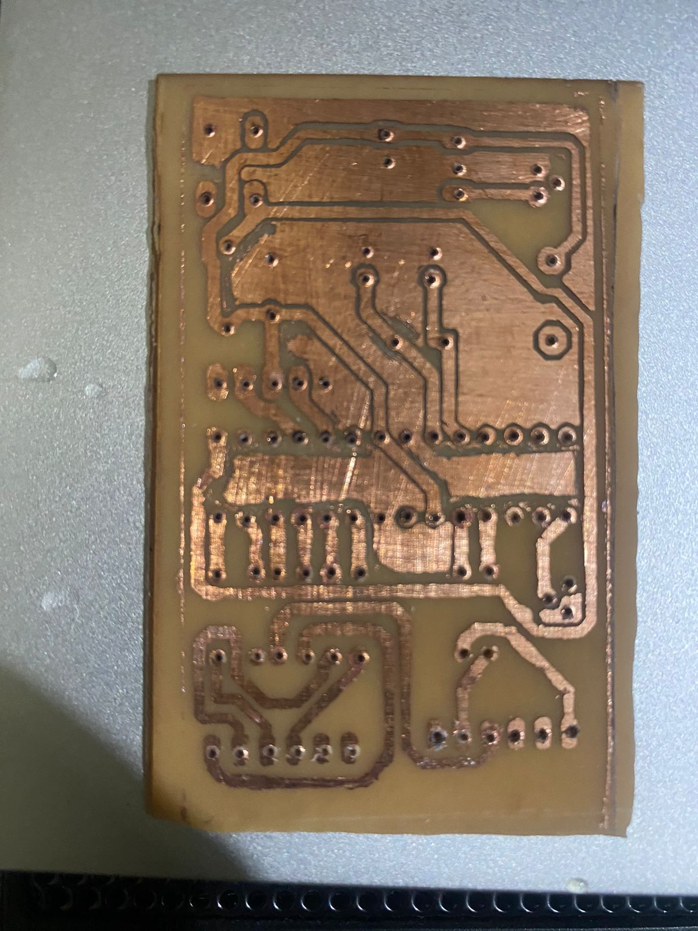
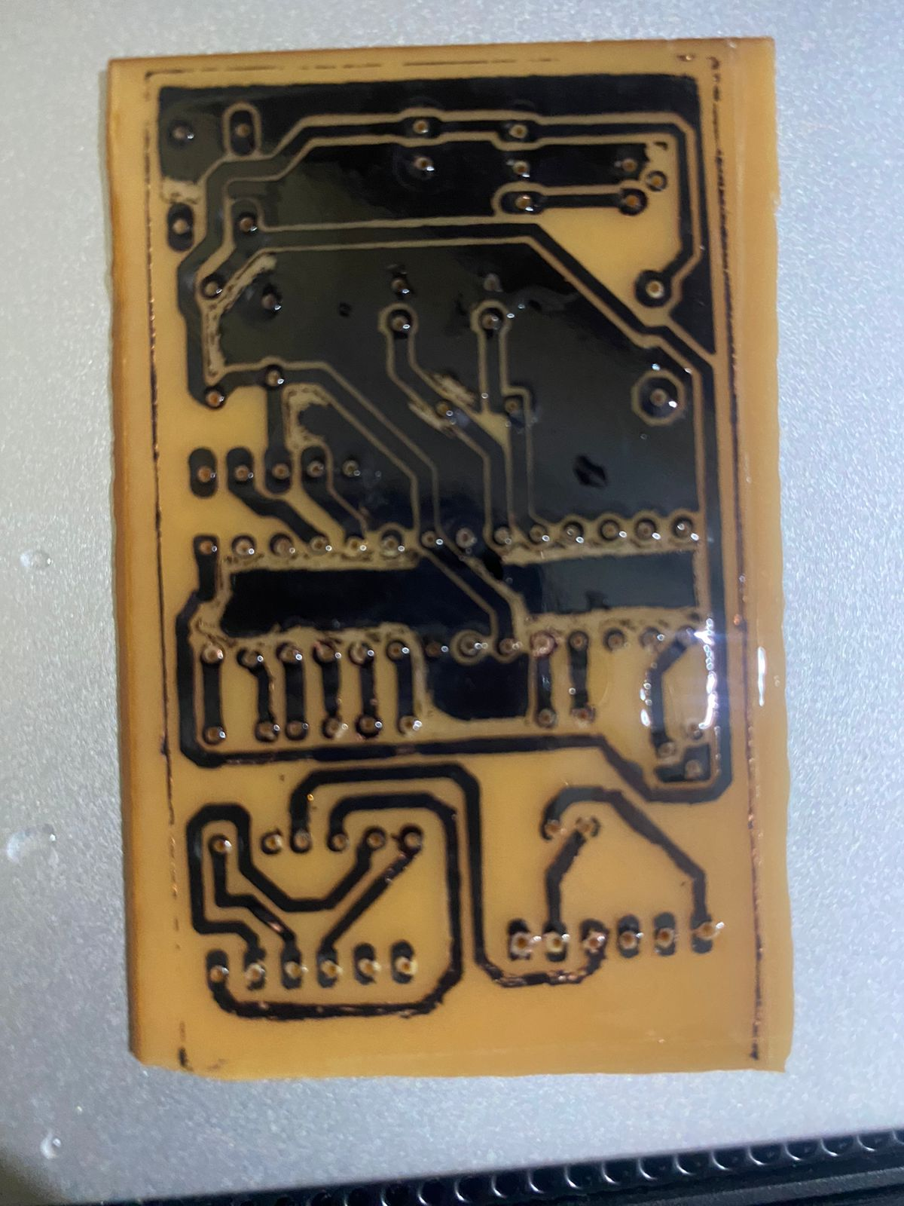
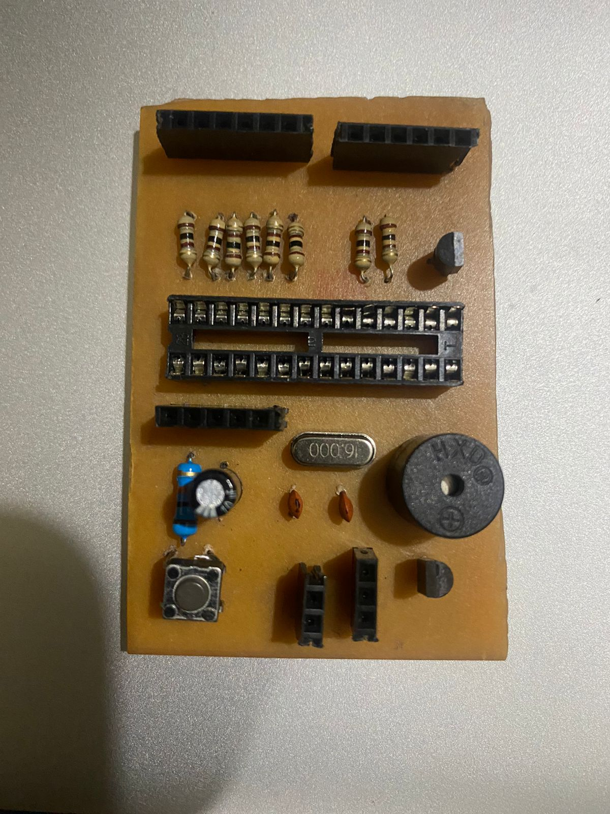

Slide 11

The product

Slide 12
Timer Display
Timer
Controller
Switch
Rotary Encoder

Slide 13

FUNCTIONs

Slide 14
functions
Can be used as a normal plug socket by disconnecting the timer using the two sided switch Using two way switch
4 digits 7 segments LED Display shows the timer set value
Rotary encoder allows setting the required timer value.
Timer can be set up to maximum 100 minutes
Rotary encoder push button used to start the timer.
Timer can be paused with a press of push button.
Second press resumes the timer.
Double Press at pause state resets the timer.

Slide 15

Thank you!

